Slide 1



DataBase Management System
Legal Case & Client
Management System
Database Design, Implementation and Application Demonstration
Student: Praveen Choudhary
Roll Number: 25WU0102215
Programme/Section: AIML (Leopards)
FACULTY
Dr. C Nagaraju

Slide 2
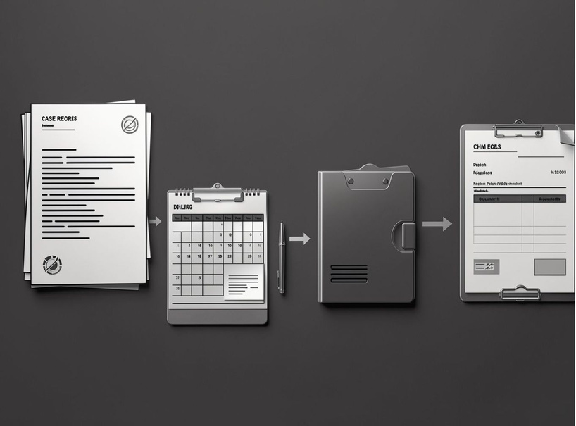
THE PROBLEM
Legal work generates connected records. Managing them separately creates risk.
  Scattered client and case records; missed hearing dates and task deadlines
  Hard-to-track documents and lawyer assignments; inaccurate time, expense and billing records
  Limited visibility into invoices and payments
OBJECTIVE
Centralize records, preserve integrity, improve deadline visibility, and simplify billing and reporting.

Slide 3
CASE LIFECYCLE
One connected workspace for the case lifecycle.
Primary users: Administrator, Lawyer, Case-management staff
  Client Registration
  Case Creation
  Lawyer Assignment
  Hearing & Task Tracking
  Document Management
  Time & Expense Recording
  Invoice
  Payment
  Reports

Slide 4
ENTITY RELATIONSHIP DIAGRAM
A relational model built around the legal case.
13 entities
Key relationships
Core
CLIENT · LEGAL_CASE · CASE_TYPE · COURT · LAWYER
Relationships
ASSIGNMENT · HEARING · DOCUMENT · TASK
Financial and effort
TIME_ENTRY · EXPENSE · INVOICE · PAYMENT
CLIENT 1 → many LEGAL_CASE
LEGAL_CASE many ↔ many LAWYER, resolved through ASSIGNMENT
LEGAL_CASE 1 → many HEARING, DOCUMENT, TASK, TIME_ENTRY, EXPENSE and INVOICE
INVOICE 1 → many PAYMENT when partial payments are supported
PK: Primary Key · FK: Foreign Key · crow’s-foot cardinality

Slide 5
Structured tables reduce duplication and update anomalies.
Representative schemas
Normalization check
CLIENT · LEGAL_CASE · LAWYER · ASSIGNMENT · HEARING · INVOICE · PAYMENT
1NF | Atomic values and no repeating groups
2NF | No partial dependency on part of a composite key
3NF | No inappropriate transitive dependency between non-key attributes
LEGAL_CASE includes case_number UNIQUE plus client_id, case_type_id and court_id foreign keys
State 3NF as the final design only after functional dependencies are checked; complete schema includes all ERD entities.

Slide 6
DATA INTEGRITY
SQLITE · EXAMPLE EXCERPT
Constraints make invalid records harder to create.
CREATE TABLE legal_case (
case_id INTEGER PRIMARY KEY,
case_number TEXT NOT NULL UNIQUE,
client_id INTEGER NOT NULL
REFERENCES client(client_id),
case_type_id INTEGER NOT NULL
REFERENCES case_type(case_type_id),
court_id INTEGER NOT NULL
REFERENCES court(court_id),
CHECK (trim(case_number) <> '')
);
  Primary and foreign keys protect identity and referential integrity; UNIQUE case numbers; NOT NULL mandatory attributes
  CHECK constraints for non-negative hours and expenses; validation for hearing and task dates
  Payment validation against invoice balances; transactions for related billing updates; indexes on frequently searched attributes
Example, not the complete script.

Slide 7
The front end turns the database into a usable workflow.
User → Java/Python Application → Validation & Business Logic → Relational Database → Queries & Reports
  Language: Python
  Front end: HTML
  Database engine: SQLite, managed through DB Browser for SQLite
  SQL queries, joins and reports
  Front-end CRUD interface

Slide 8
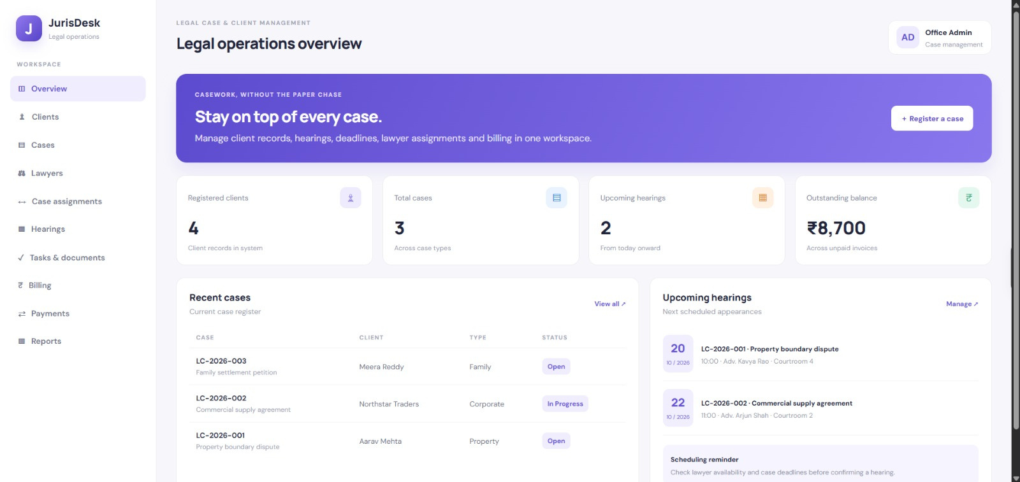
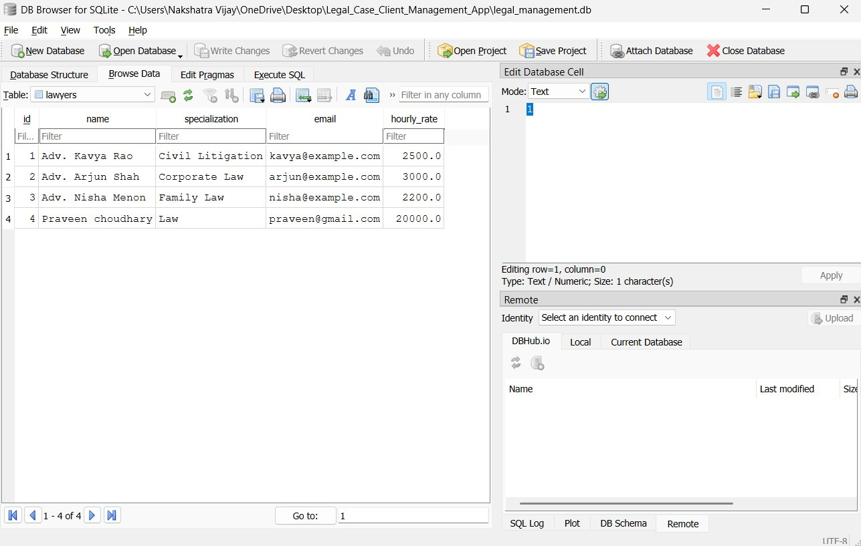
APPLICATION EVIDENCE
Application dashboard
From registration to case tracking.
Browser and application chrome retained where it establishes authenticity.
SQLite database evidence

Slide 9
OPERATIONAL DECISIONS
Test scenario | Expected validation
Duplicate case number | UNIQUE constraint prevents the duplicate record
Invalid hearing date | Date validation rejects the invalid record
Negative time or expense | CHECK constraint rejects the negative value
Payment over outstanding balance | Payment validation rejects the excess amount
Search by case number | Search returns the matching case record
The database supports operational decisions.
Reports cover upcoming hearings, pending tasks, lawyer workload, billable time and expenses, outstanding invoices, and case status summaries.
SQL concepts: JOINs, GROUP BY, aggregates, subqueries, views, search and filtering.
Expected validation is shown; actual test outcomes are not supplied.

Slide 10
CLOSING REVIEW
WHAT THE SYSTEM CONNECTS
  Centralized client and case records
  Connected hearings, documents, tasks and assignments
  Structured time tracking, expenses and billing
  Referential integrity and normalized database design
  Searchable records and reporting
A more traceable,
organized legal workflow.
FUTURE SCOPE
Role-based access control, automated reminders, secure document storage, PDF invoices, audit logs and backups.
Thank You — Questions & Discussion

